Slide 1
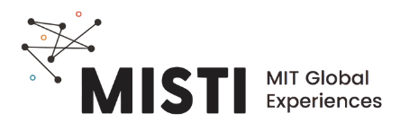
Fabric Properties

Slide 2
Fabric properties depend on both fiber identity and knit
Tightly knit fibers reduce breathability
Tightly knit fibers have a greater contact with skin, increasing moisture wicking
The inherent chemical properties of the fiber impact water absorption, but coatings can obscure the effect.
Images of different types of knit patterns
Notes:
https://www.rushordertees.com/blog/does-polyester-shrink/

Slide 3
Desirable fabric properties
Representative images for each fabric property
water-repellant
(hydrophobic)
stretchy
(elastic)
comfort
(heat retention, breathability)

Slide 4
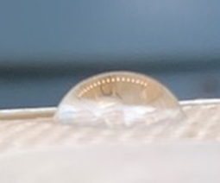
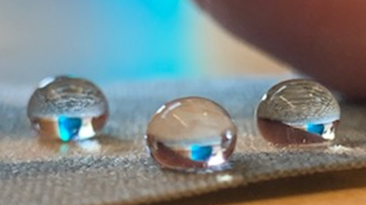
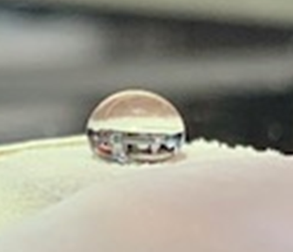
Hydrophilicity from contact angle
Schematic image that shows how the measured contact angle relates to the hydro- classification of the material
hydrophilic
cotton
Super hydrophobic
Water-repellent coating
hydrophobic
polyester
Photos courtesy of Haley Beech

Slide 5
Stretch from fiber and knit
Semi-crystallinity lends strength and stretch to fiber
Insert schematic image demonstrating stretch and recovery of semi-crystalline fibers
Insert schematic image demonstrating stretch and recovery of a knit material
Stretch
Recover
Schultz, j., Polymer Material Science, 1974.
Notes:
https://refiberdesigns.com/blog/the-why-and-how-of-stretch-fabrics

Slide 6
Breathability- key in a Brazilian summer
Breathability is the ability to transport moisture in the vapor state from an area of higher to lower humidity.
As your body heats up, the moisture vapors are absorbed by the fiber and released to the drier environment outside
Wool fiber can absorb and retain up to 30% of its own weight in moisture and still feel dry to the touch.
Representative schematic of breathable material and working principles
Skin
Micro
climate
Fabric
External
Environment
Notes:
https://www.smartwool.com/discover/why-merino-wool/merino-wool-101.html

Slide 7
Itchy? Try a finer fiber
The “itchiness” associated with some fabrics like wool is determined by the diameter of the fibers used.
Larger, broader fibers are less flexible and have less ability to bend, which results in a prick when pressed against the skin, causing the sensation of itch.
SEM image of fibers of various roughness
Notes:
https://www.smartwool.com/discover/why-merino-wool/merino-wool-101.html

